Slide 1
Data Structures And Algorithms

Slide 2
Insertion in BST
Check the value to be inserted (say X) with the value of the current node (say val) we are in:
If X is less than val move to the left subtree.
Otherwise, move to the right subtree.
Once the leaf node is reached, insert X to its right or left based on the relation between X and the leaf node’s value.

Slide 3
Insertion in BST
void BST::insert(int value)
{
//Node create:
Node*nn = new Node;
nn->data = value;
nn->leftChild = nullptr;
nn->rightChild = nullptr;
if (root == nullptr) //empty tree case
root = nn;
else { -------------- }

Slide 4
Tree traversal
Traversal is a process to visit all the nodes of a tree and may print their values too.
Because, all nodes are connected via edges (links) we always start from the root (head) node. That is, we cannot randomly access a node in a tree.
There are three ways which we use to traverse a tree −
In-order Traversal
Pre-order Traversal
Post-order Traversal

Slide 5
In-order Traversal
In this traversal method, traversal method is as follows:
the left subtree is visited first,
then the root
then the right sub-tree.
We should always remember that every node may represent a subtree itself.
If a binary tree is traversed in-order, the output will produce sorted key values in an ascending order.

Slide 6
Pre-order Traversal
The steps to perform the preorder traversal are listed as follows -
First, visit the root node.
Then, visit the left subtree.
At last, visit the right subtree.

Slide 7
Post-order Traversal
Post-order traversal is used to get the postfix expression of a tree.
The following steps are used to perform the post-order traversal:
Traverse the left subtree
Traverse the right subtree
Root node is traversed at last

Slide 8
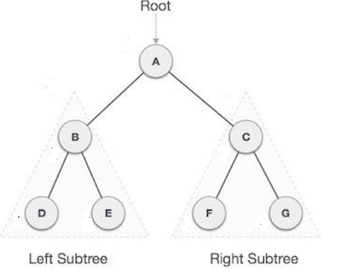
Tree traversal

Slide 9
Tree traversal
Post-order: D → E → B → F → G → C → A
Pre-order: A → B → D → E → C → F → G
In-order: D → B → E → A → F → C → G

Slide 10
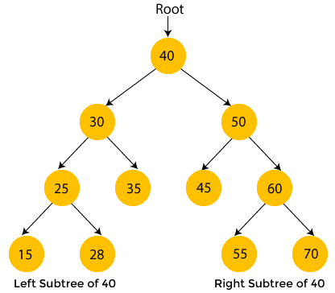
Tree Traversal

Slide 11
Tree traversal
Pre-order: 40, 30, 25, 15, 28, 35, 50, 45, 60, 55, 70
Post-order: 15, 28, 25, 35, 30, 45, 55, 70, 60, 50, 40
In-order: 15, 25, 28, 30, 35, 40, 45, 50, 55, 60, 70

Slide 12
In-order trversal
void BST::INORDER(Node*p)
{
if (p != nullptr)
{
INORDER(p->leftChild);
cout << p->data << endl;
INORDER(p->rightChild);
}
}

Slide 13
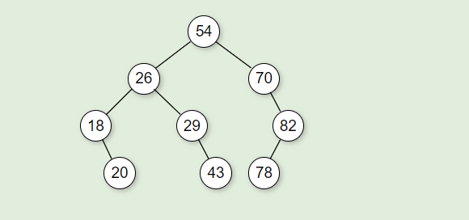
Tree traversal

Slide 14
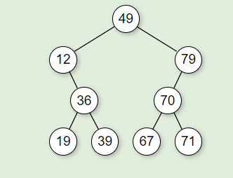
Tree traversal

Slide 15
Deletion in BST
Delete function is used to delete the specified node from a binary search tree.
However, we must delete a node from a binary search tree in such a way, that the property of binary search tree doesn't violate.
There are three situations of deleting a node from binary search tree.
The node to be deleted is a leaf node
The node to be deleted has only one child
The node to be deleted has two children.

Slide 16
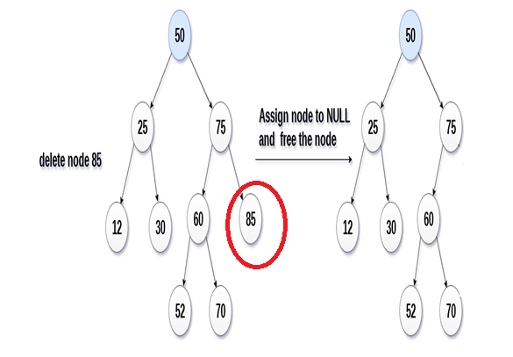
node to be deleted is a leaf node
It is the simplest case, in this case, replace the leaf node with the NULL and simple free the allocated space.
In the following image, we are deleting the node 85, since the node is a leaf node, therefore the node will be replaced with NULL and allocated space will be freed.

Slide 17
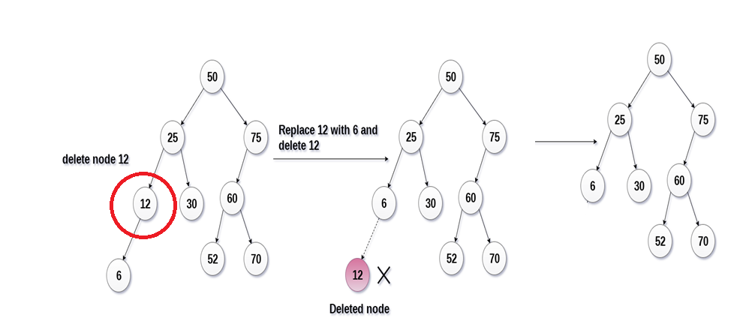
node to be deleted has one child
In this case, replace the node with its child and delete the child node, which now contains the value which is to be deleted. Simply replace it with the NULL and free the allocated space.
In the following image, the node 12 is to be deleted. It has only one child. The node will be replaced with its child node and the replaced node 12 (which is now leaf node) will simply be deleted.

Slide 18
node to be deleted has two children
It is a bit complexed case compare to other two cases.
However, the node which is to be deleted, is replaced with its in-order successor or predecessor i.e. find the smallest node in the right subtree.
Replace the value of current node with the in-order successor or predecessor
After the procedure, replace the node with NULL and free the allocated space.

Slide 19
node to be deleted has two children

